Slide 1
2023
Wooster IB graduation
Welcome Family, friends, teachers, administration and special guests

Slide 2
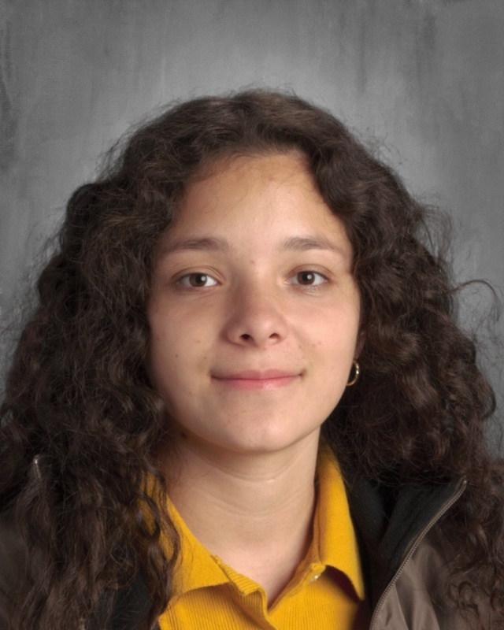
Melanye aguirre

Slide 3
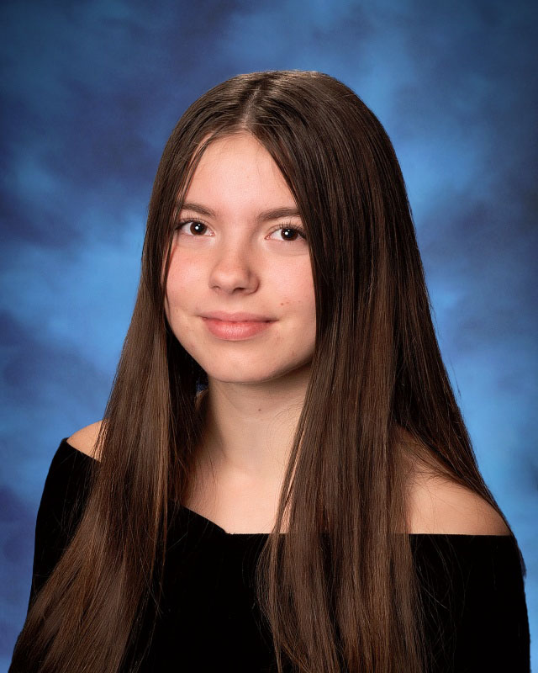
Isabelle aucoin

Slide 4
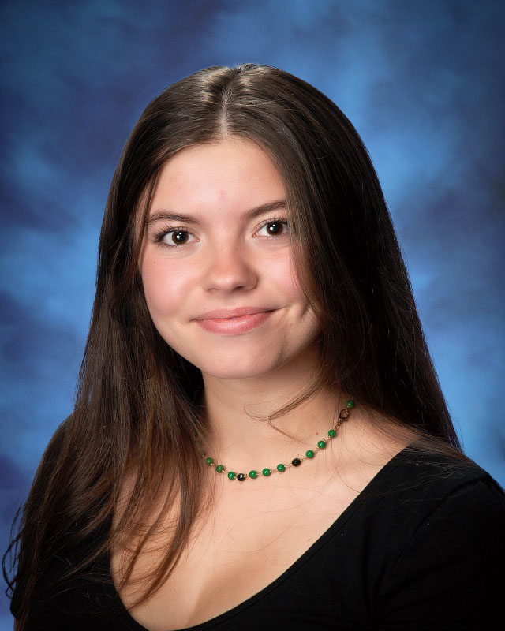
Rose aucoin

Slide 5
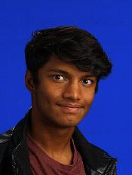
Anish bayya

Slide 6
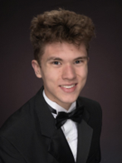
Mj boga

Slide 7
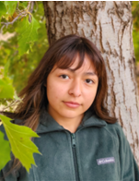
Abigail
Cabrera cervantes

Slide 8
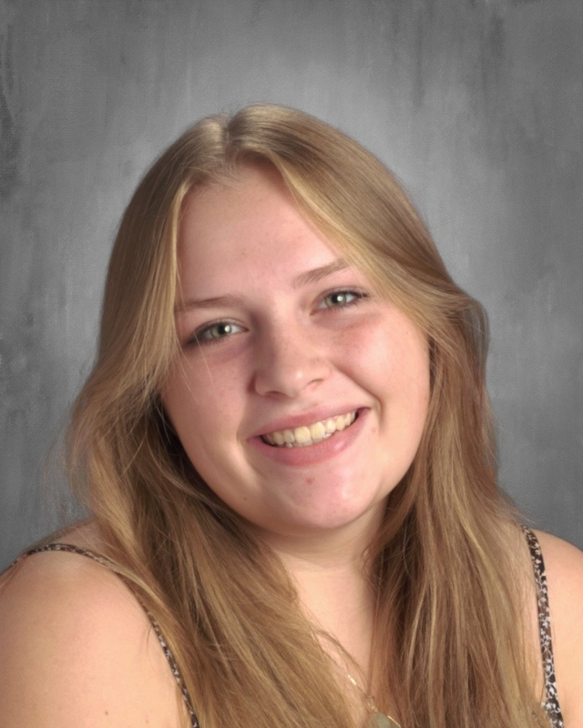
Cara
Chacon

Slide 9
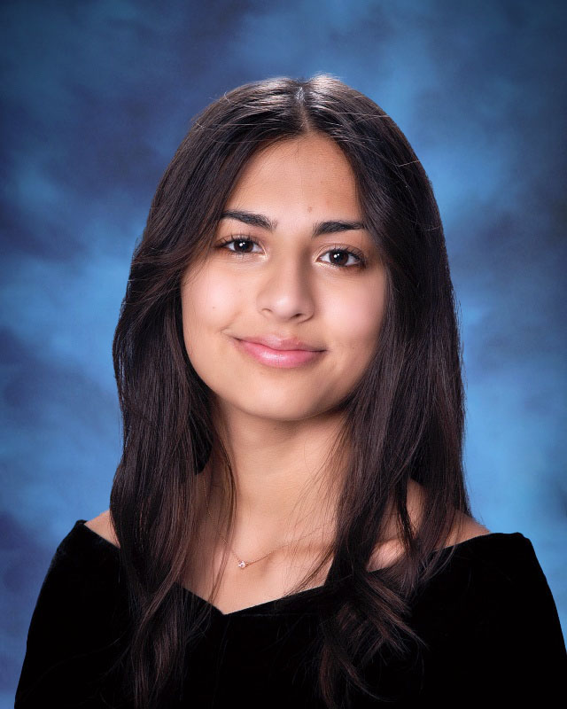
Emily chapman

Slide 10
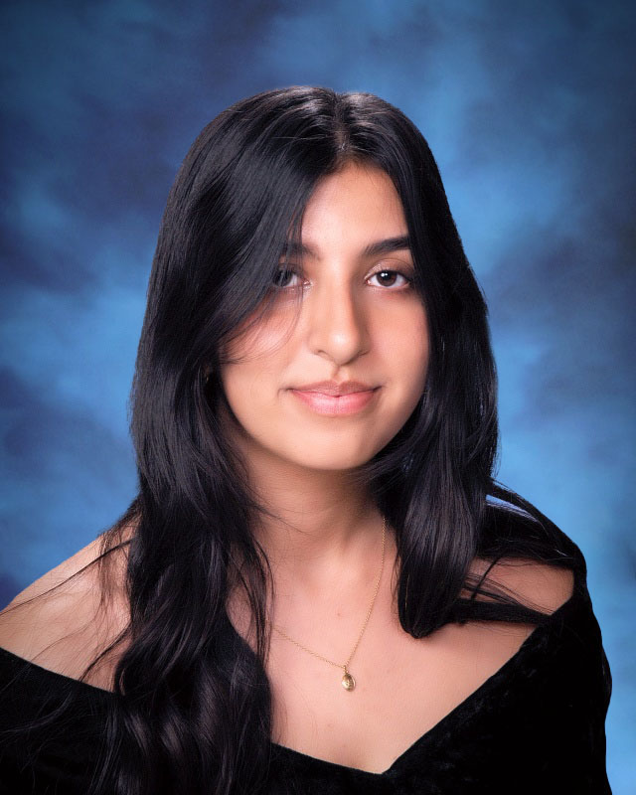
Raveena cheema

Slide 11
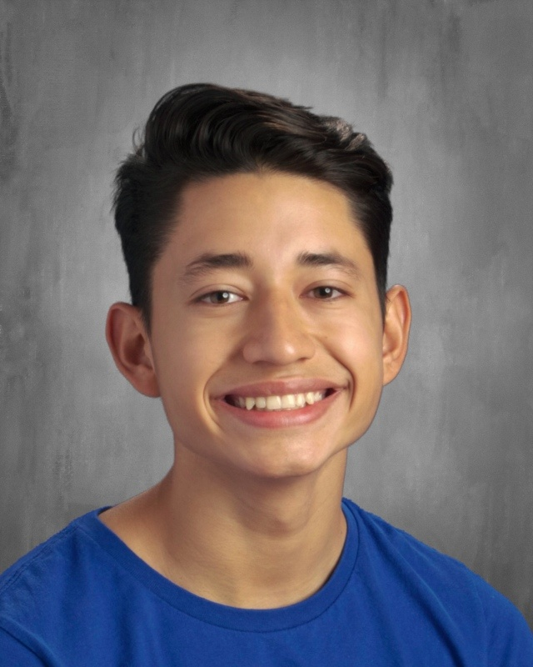
Jeferson cordova solares

Slide 12
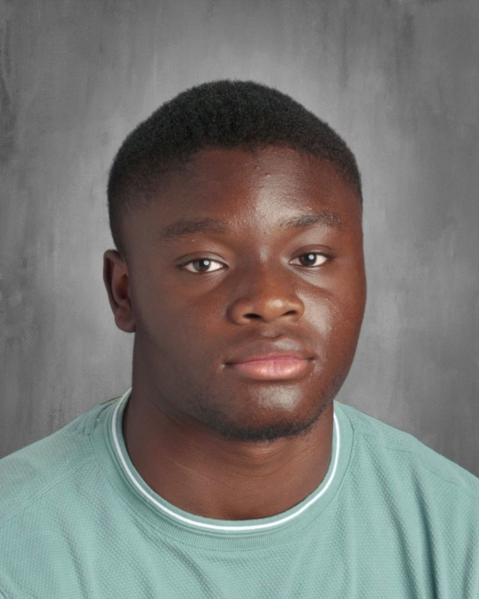
Adama junior coulibaly

Slide 13
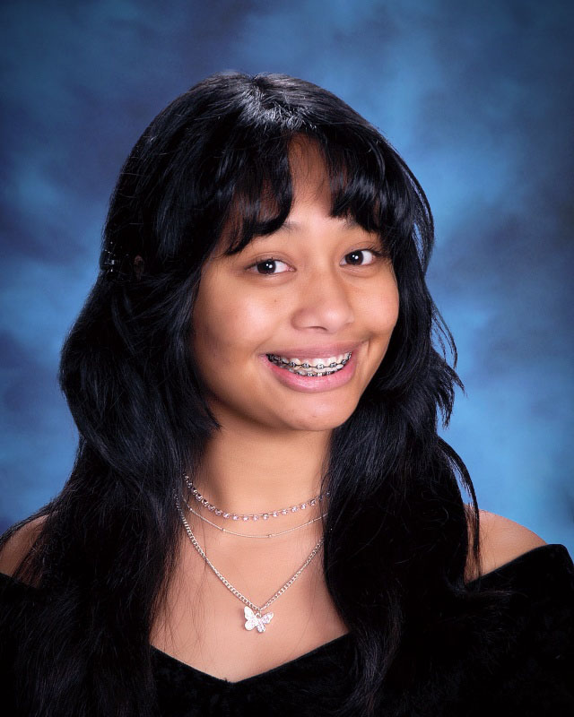
Chantal
Ebonia

Slide 14
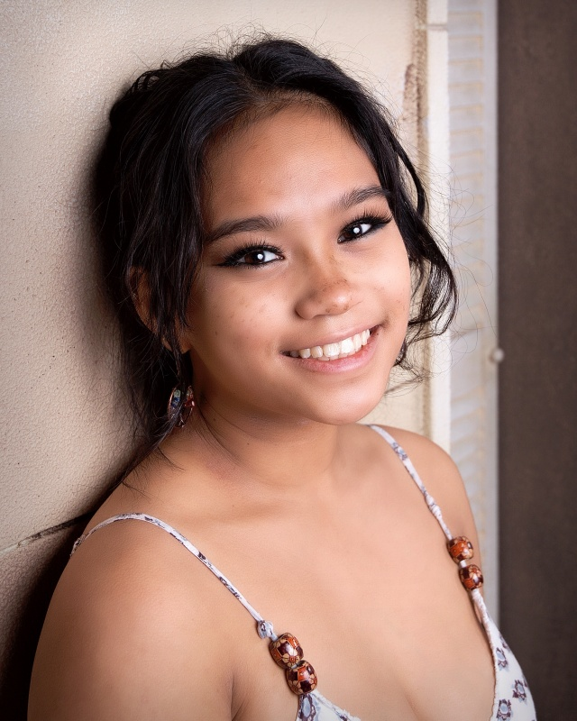
Kainah fernandez

Slide 15
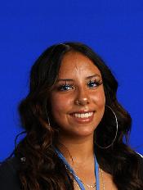
Selina
Fernandez huerta

Slide 16
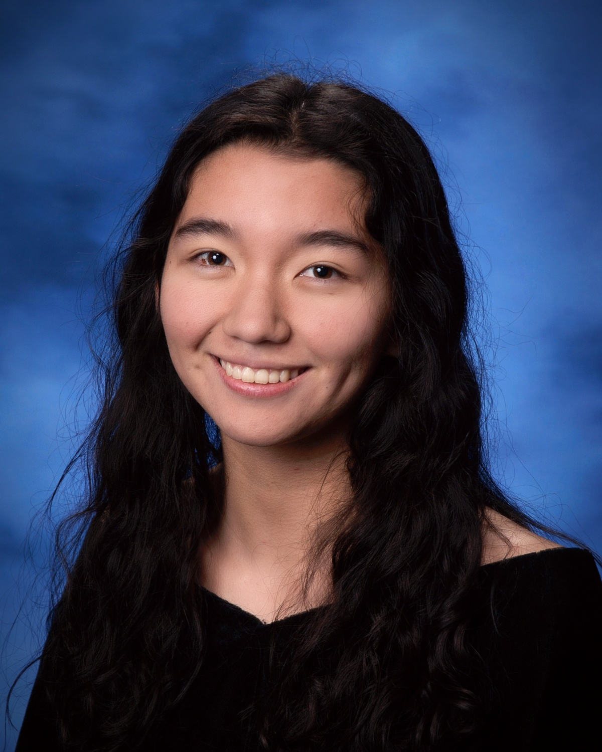
Kanela furuta

Slide 17
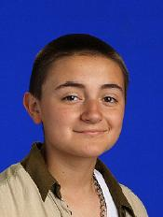
Frankie galaviz

Slide 18
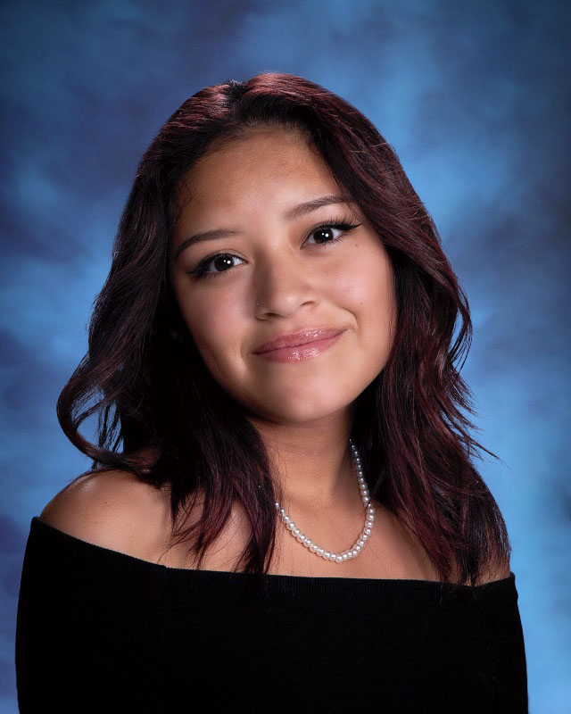
Isis garcia cruz

Slide 19
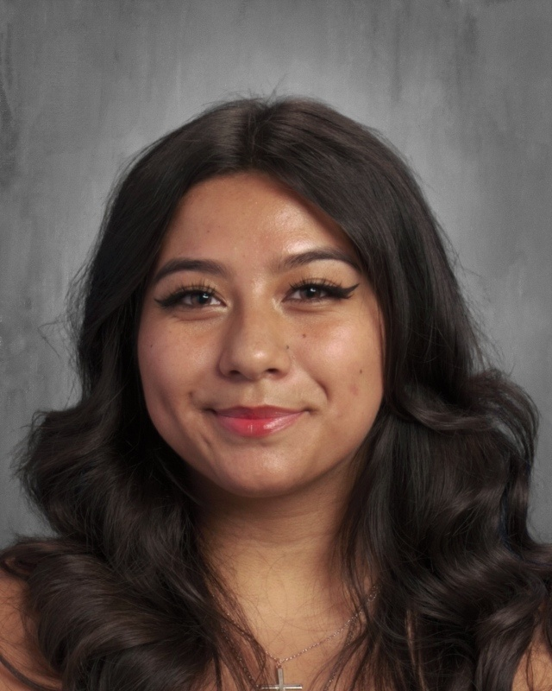
Brenda
Gonzalez lopez

Slide 20
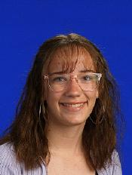
Cheyanne horton

Slide 21
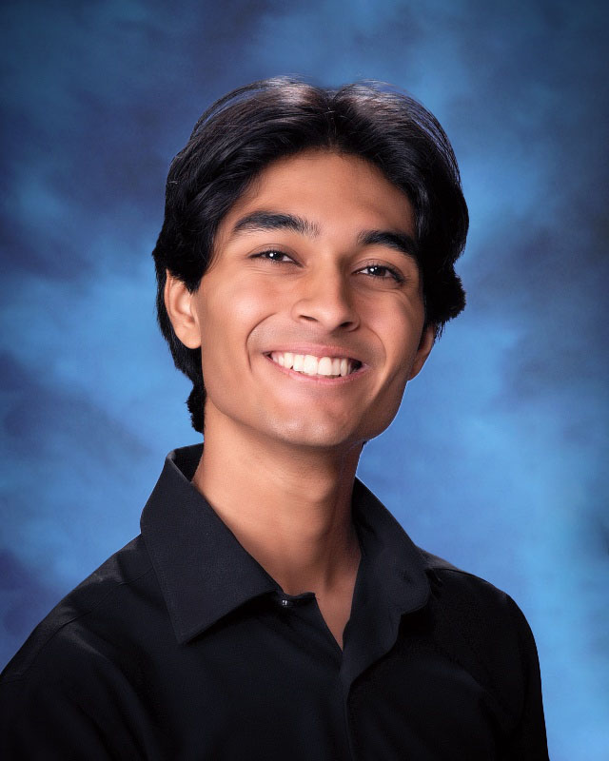
Adam jackson

Slide 22
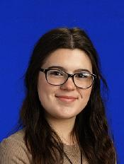
Emma kennedy

Slide 23
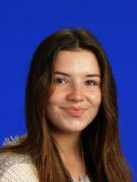
Jillian kirgin

Slide 24
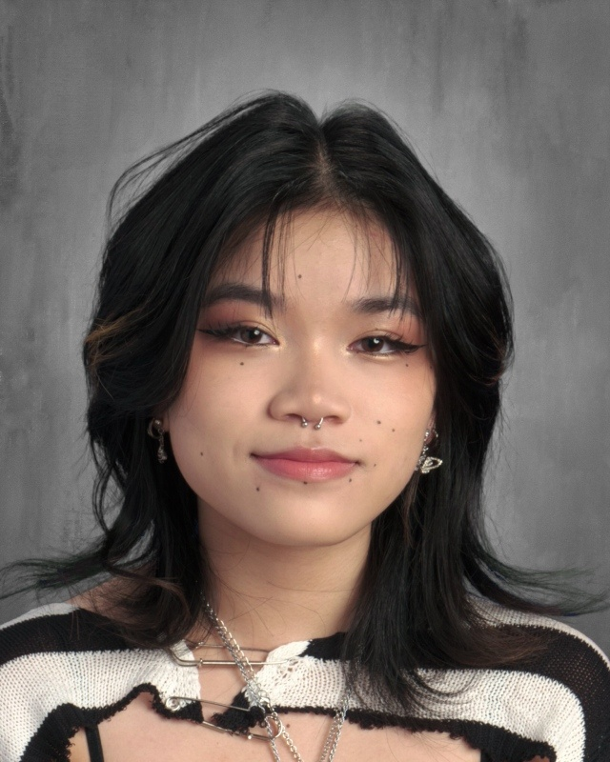
Darcy lo

Slide 25
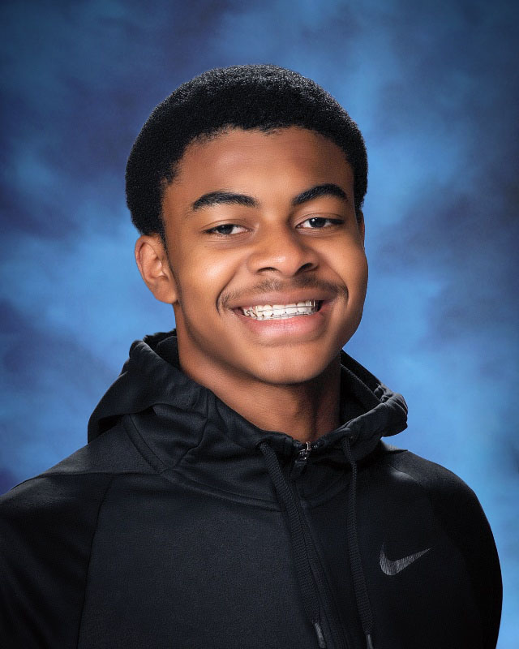
Jaylen logan

Slide 26
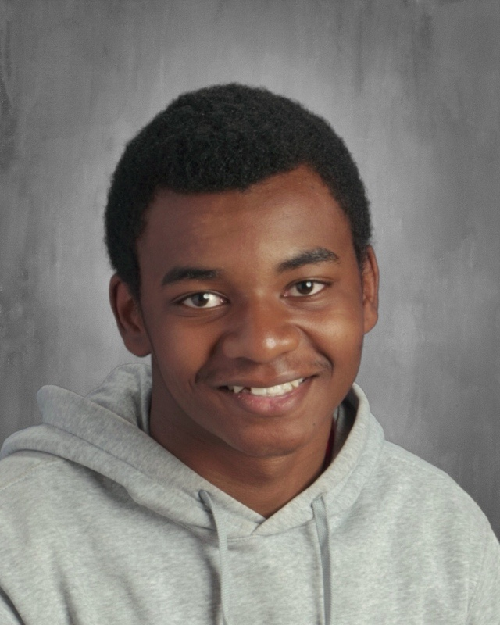
Julien logan

Slide 27
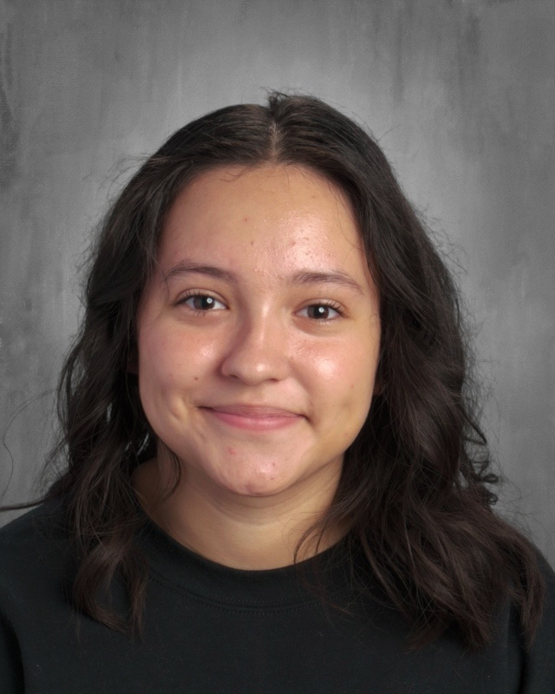
Tania luna garcia

Slide 28
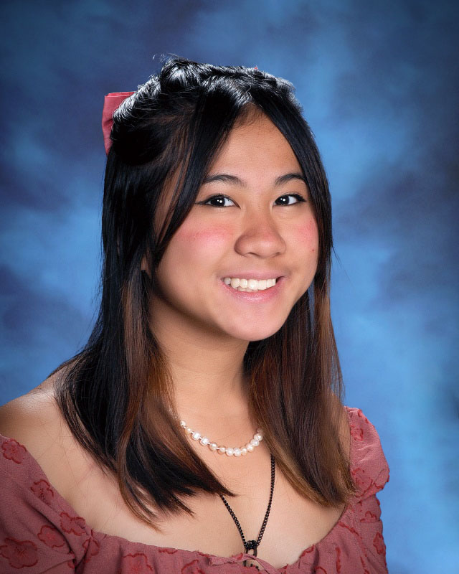
Kianna magno

Slide 29
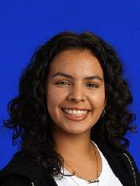
Dania mayorquin rosas

Slide 30
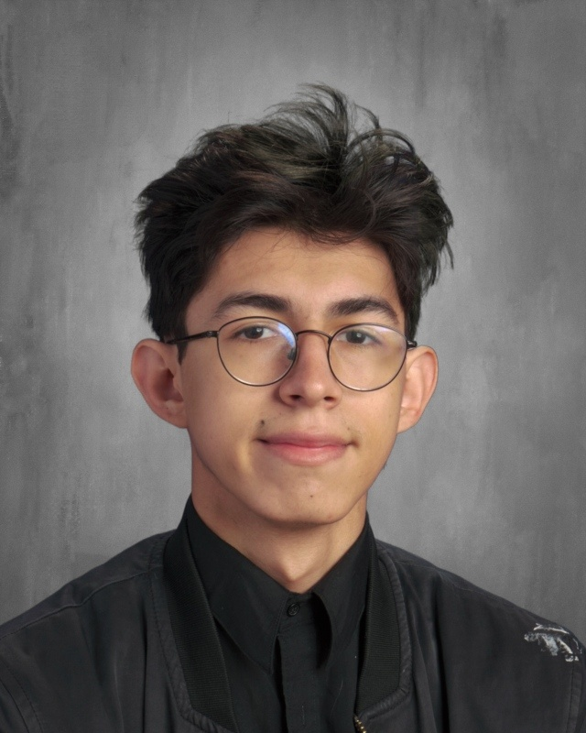
Esdras mora navarro

Slide 31
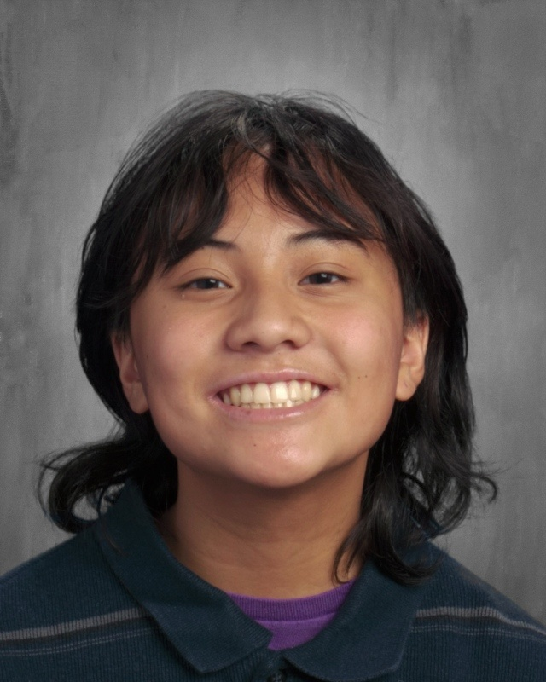
Shaina munoz

Slide 32
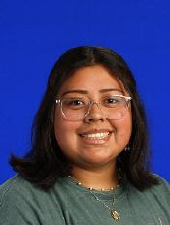
Veronica munoz diaz

Slide 33
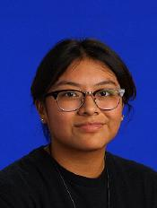
Makayla ondelacy

Slide 34
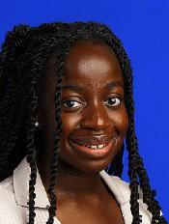
Basha owusu amankonah

Slide 35
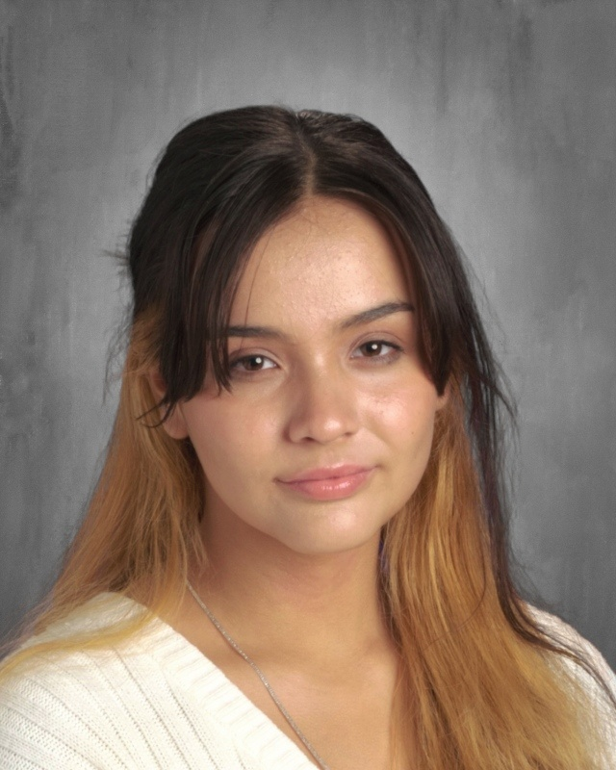
Helen pacheco

Slide 36
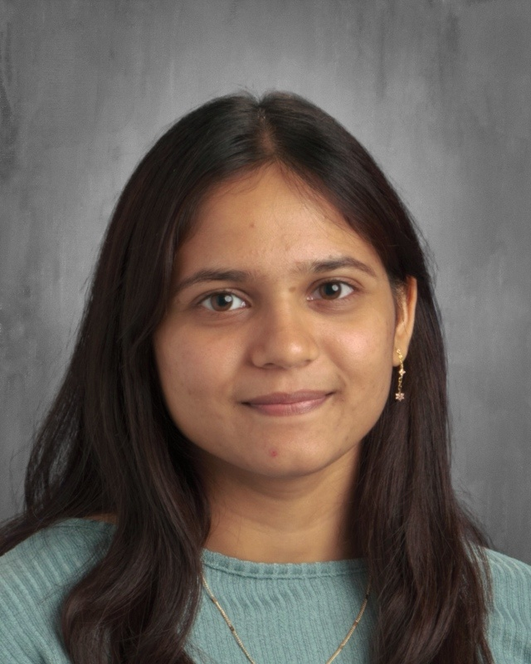
Bansari patel

Slide 37
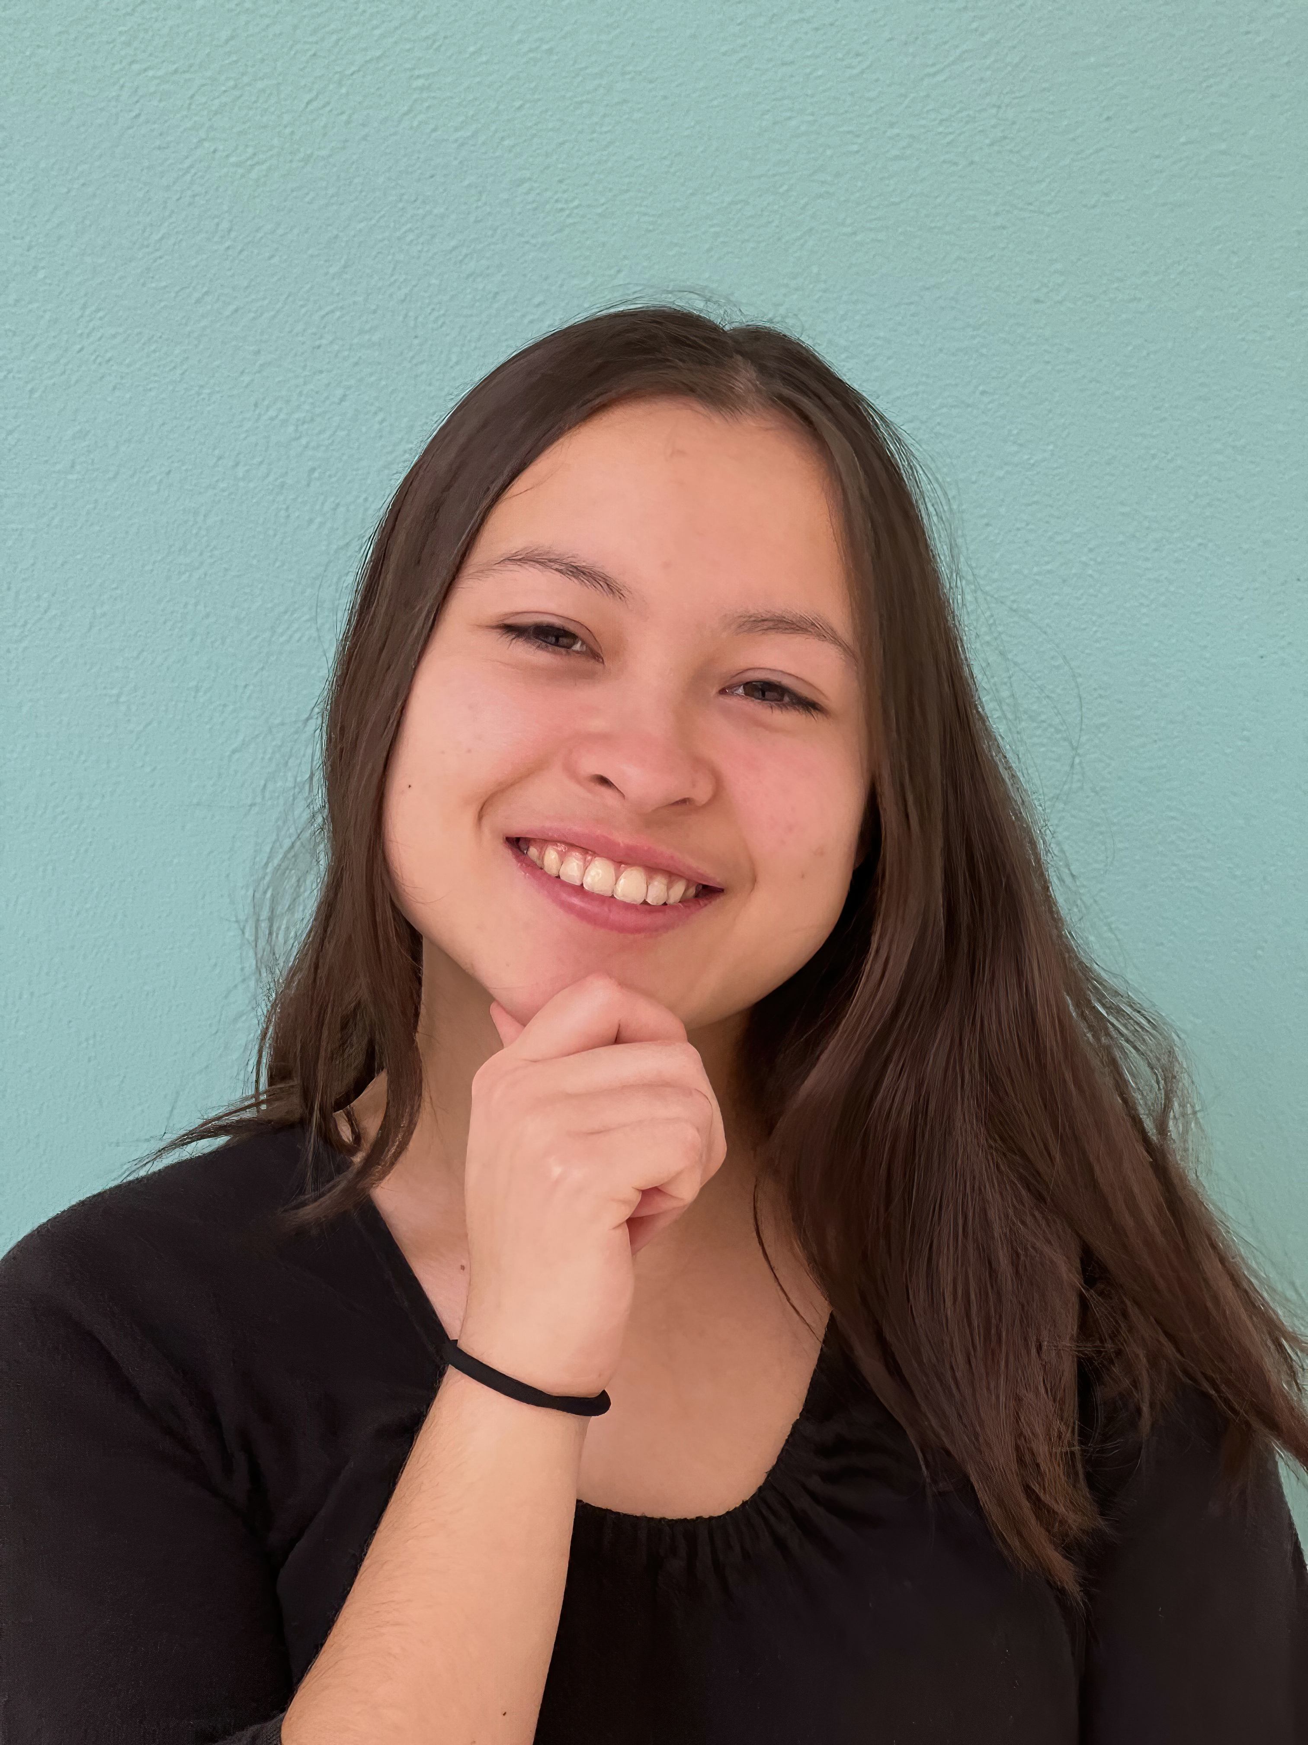
Bella peoples

Slide 38
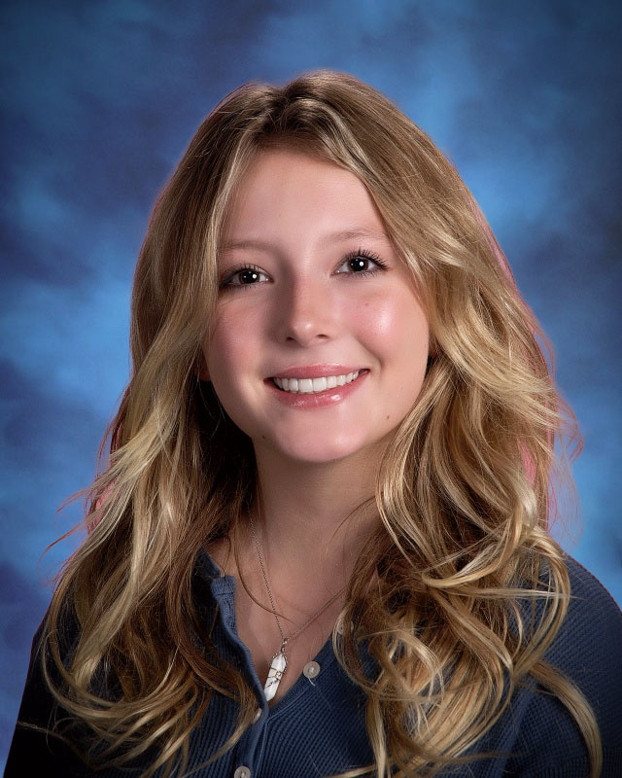
Caroline perry

Slide 39
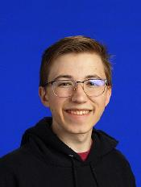
Eli povolny

Slide 40
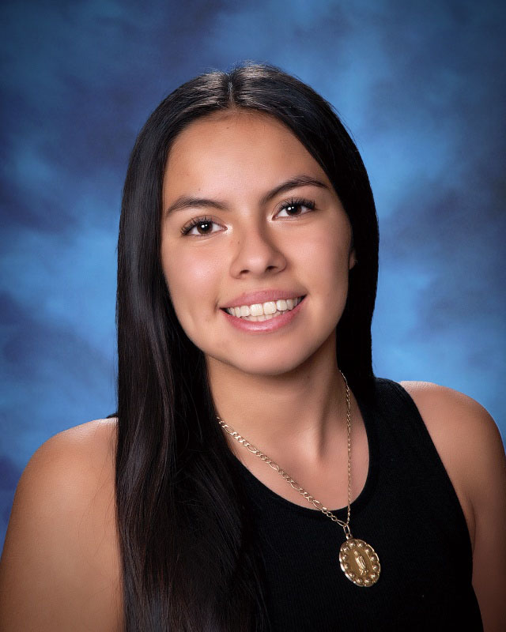
Monserrath
Ramirez ramirez

Slide 41
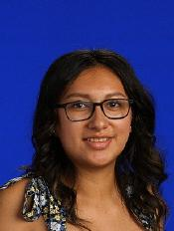
Fernanda ramos- rodriguez

Slide 42
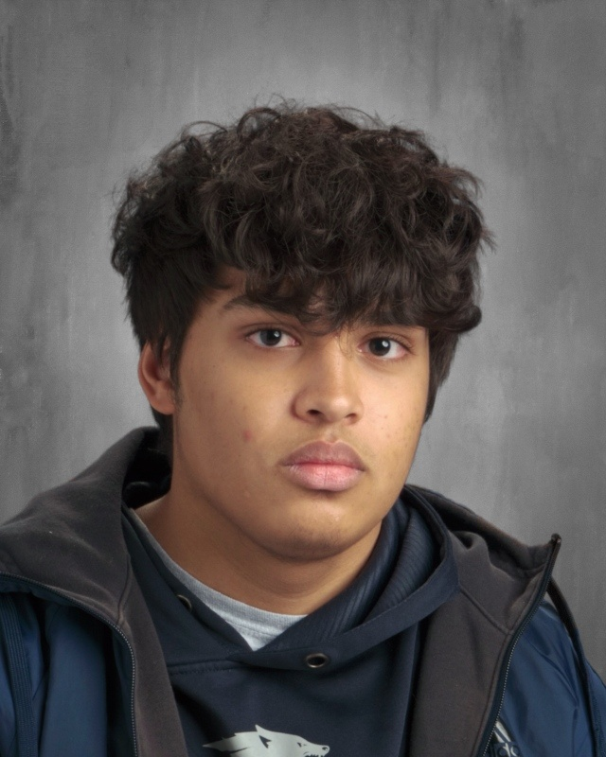
Shawon razzak

Slide 43
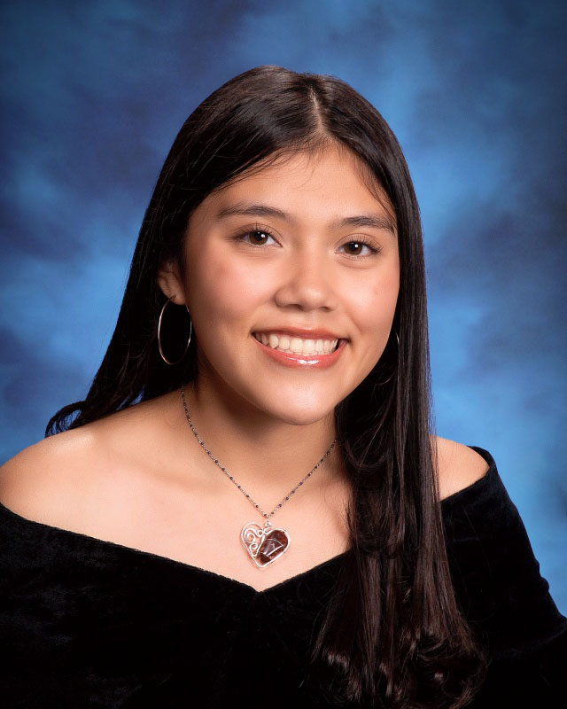
Sarai reyes quezada

Slide 44
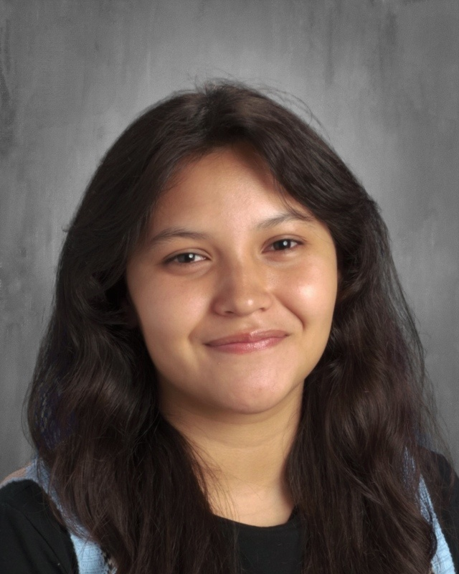
Vivianna rodriguez

Slide 45
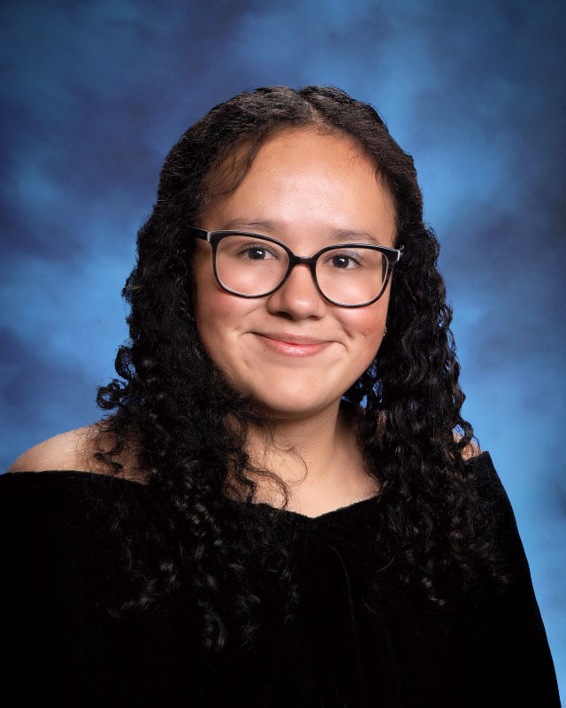
Jennifer rodriguez reynoso

Slide 46
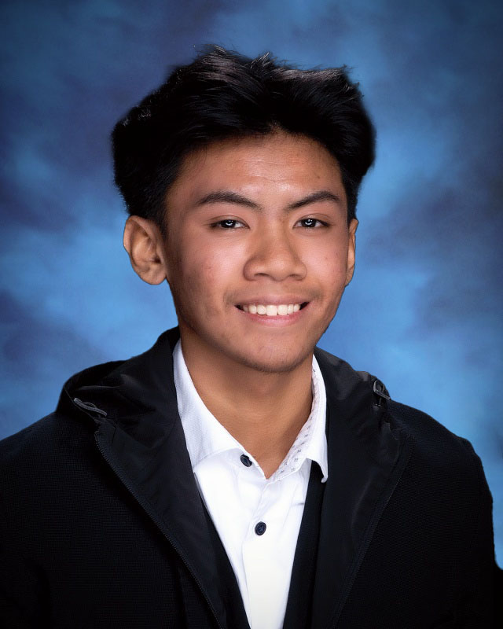
Jarenz romero

Slide 47
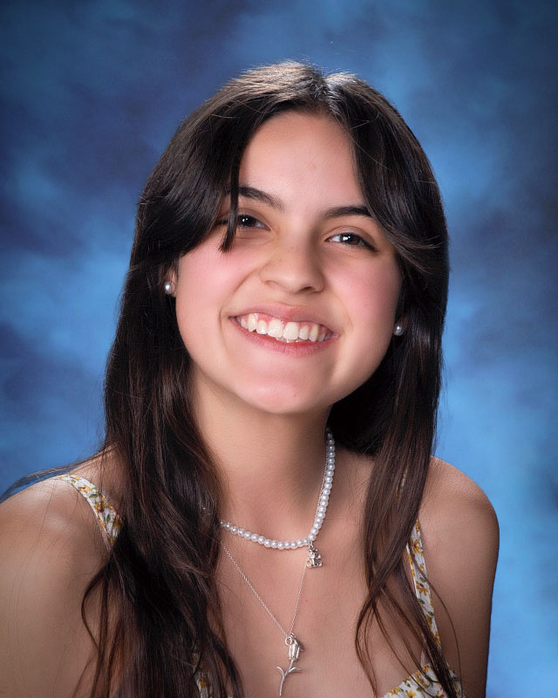
Catalina salvatore

Slide 48
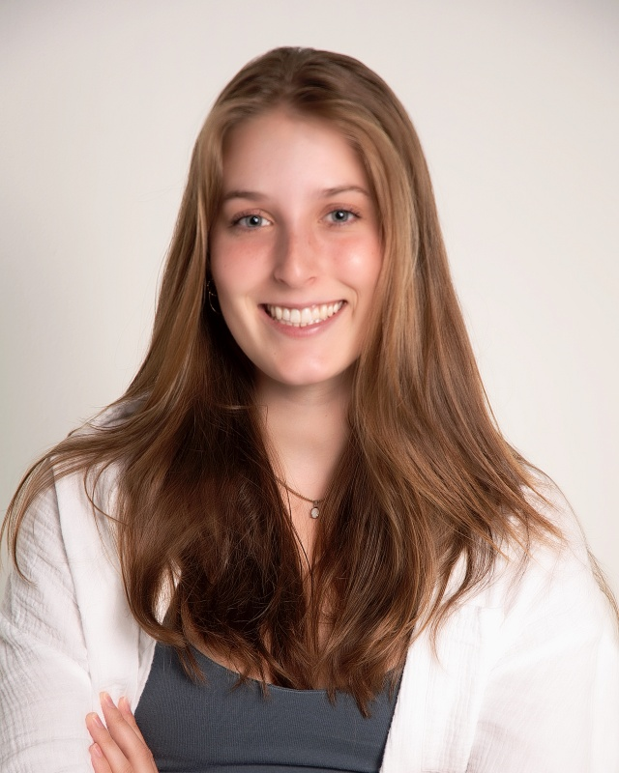
Olivia schreinert

Slide 49
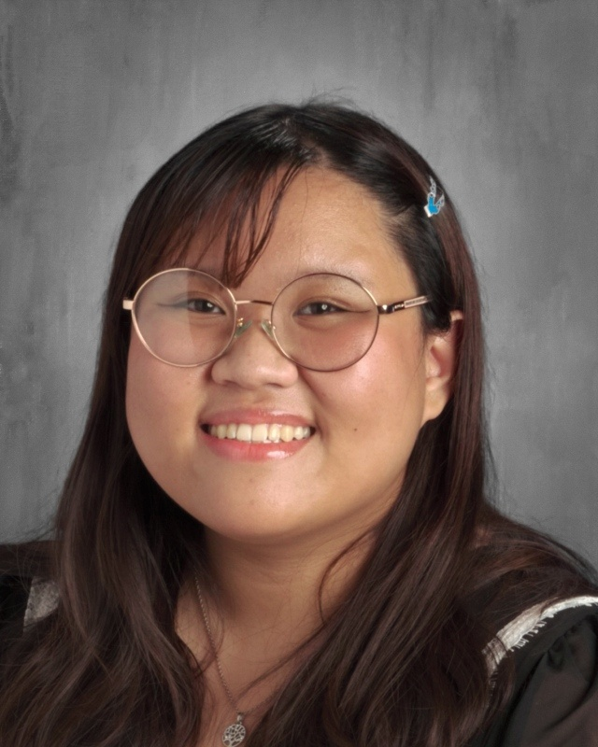
Kichi venice selag

Slide 50
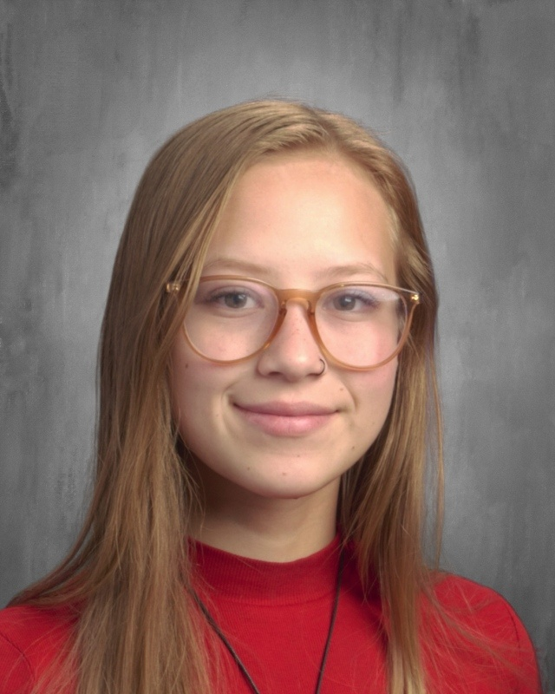
JORDAN
STEPHENSON

Slide 51
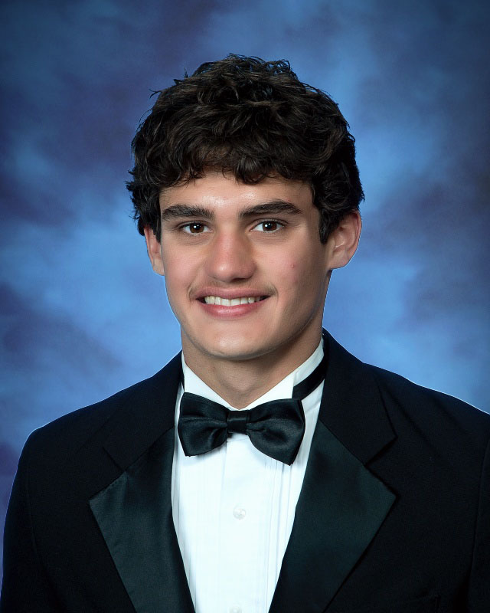
IVAN
STRUNK

Slide 52

ANIELYN
TOLEDO-UNCIANO

Slide 53

DAVID
VAQUERA

Slide 54

KAYLA JO
VASS

Slide 55

KYLEE
VEGA

Slide 56

JUSTIN
WANG

Slide 57

HALEY
WARD

Slide 58

DAVID
WEST

Slide 59

SAGE
WILKERSON

Slide 60

PEYTON
WILSON

Slide 61

AUBREE
WILSON
ENOH

Slide 62

DIEGO
YESSILTH

Slide 63

NIA
YOUNG

Slide 64

RYAN
STRYKER
ZERR

